Slide 1
ADAPTIVE MELODIES
A USER-SHIFT PREFERENCE MUSIC RECOMMENDATION SYSTEM
Exploring how Adaptive Melodies uses advanced machine learning to adapt to changing user music preferences...
Presented By
Samuel Oyeneye

Slide 2
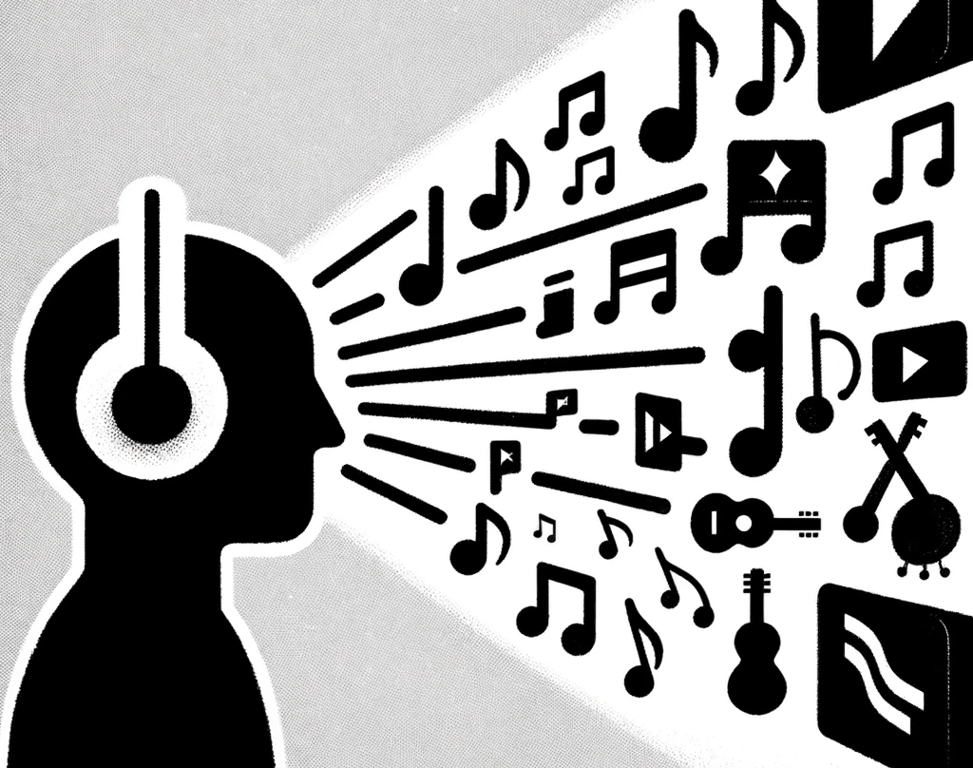
Project Overview
Problem Statement: “The motivation for this project is to address Static Recommendations in Music Streaming"

Slide 3
Project Overview
Proposed Solution: "Based on existing research, this project aims at Implementing a User-Shift Preference System with Time-Decay Collaborative Filtering (TDCF) and Graph Neural Networks (GNN)"
Project Goals: "To Enhance user experience by providing dynamic, personalized music recommendations."

Slide 4
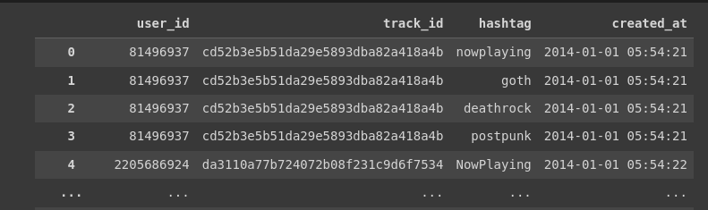
Data Source
Data Source: "#nowplaying-RS Benchmark Dataset - A rich collection of user music listening events."

Slide 5
Technical Approach
Collaborative Filtering Matrix: "Standard user-item interaction matrix without time consideration."
Time-Decay Collaborative Filtering (TDCF) algorithm: "Utilizes time-stamped user interactions to give more weight to recent preferences."
Graph Neural Networks (GNN) algorithm: "Harnesses the power of relational data between users and tracks. It uses nodes (like users or items in a recommendation system) for representation and edges (the relationships or interactions between nodes)”

Slide 6
Model Building Process
Data gathering
Dataset: #nowplaying-RS dataset.
Reason: Chosen for its comprehensive user interaction data and timestamps, crucial for understanding user-shift preferences in music.
Model training (TDCF)
Collaborative Filtering: Implemented using Scikit-learn's TruncatedSVD for dimensionality reduction, essential in handling sparse data.
Time-Decay Weighting: Applied an exponential decay function to interactions, emphasizing recent activities to reflect changing user preferences.

Slide 7
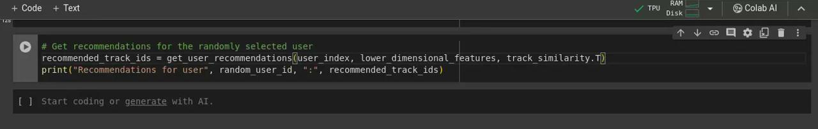
Current Progress & Challenges
The project is currently in its model building phase. Algorithm implementation and comparison
Challenges faced and how I overcame them:
data sources
large size data
data sparsity
preliminary results

Slide 8
Next Steps and Conclusion
The upcoming phase on this project are;
GNN model
Algorithm evaluation/comparison
Potential impact of Adaptive Melodies:
User Experience
Innovation in Music Streaming
Personal Information:
Github: @neyedhayo
Email: samueloyeneye1@gmail.com

Slide 9
Thank you for listening!

